Slide 2

Slack Stealing Gordan Konevski

Slide 3
Real-Time Systems

Slide 4
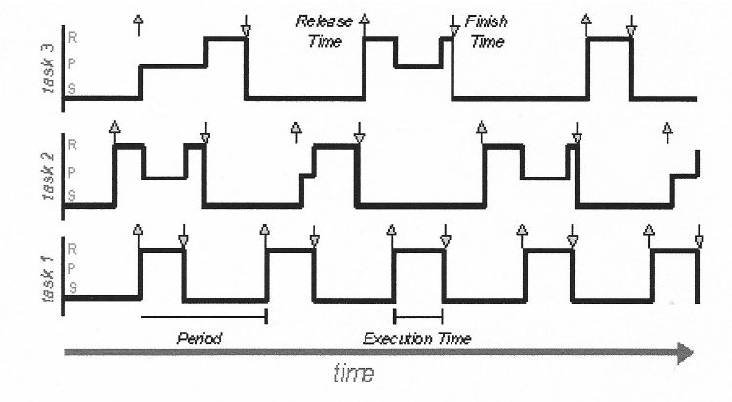
Notes:
Periodic tasks execute critical control activities with hard timing constraint, done in loops
Time-Driven or Time-Triggered

Slide 5
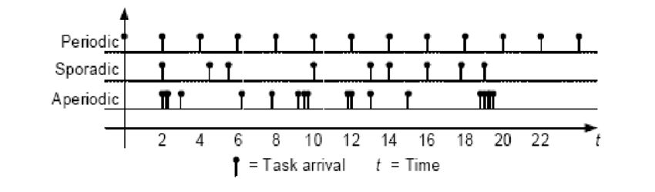
Notes:
Event triggered
Not fixed
May be used to implement change or just provide info, or just solve algos
With hybrid tasks sets, the kernel tries to guarantee the execution of hard real time, and provide a decent response for the soft and non-real time
Aperiodic tasks associated with critical events are characterized by a minimum interarrival time (time between two instances), aka sporadic

Slide 6
Technicalities

Slide 7

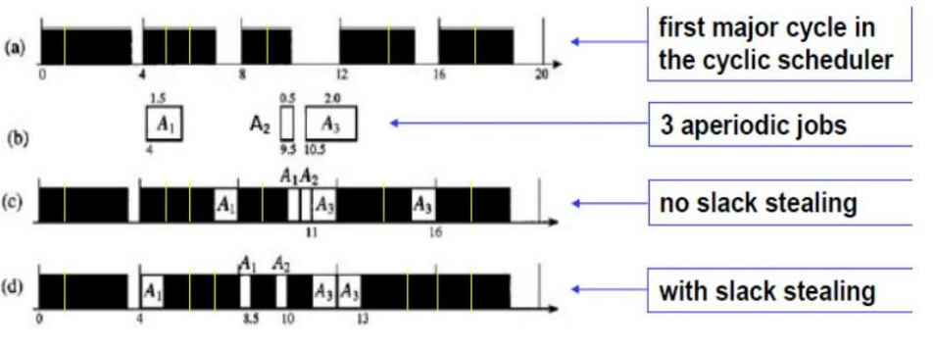
Notes:
Used for aperiodic tasks
Instead of making a periodic task, it makes a passive task (Slack Stealer) that “steals” CPU processing time from periodic tasks
Only used if there is no benefit of having periodic tasks finished early
-> Assumptions:
Periodic tasks are scheduled based on a fixed-priority assignment
All periodic tasks start simultaneously at time t = 0 and their relative deadlines are equal to their periods
Arrival times of aperiodic requests are unknown
When not explicitly specified, the minimum interarrival time of a sporadic task is assumed to be equal to its deadline
All tasks are fully preemptable (pauseable/interruptible)

Slide 8
Fast Slack Method: An Example

Slide 9
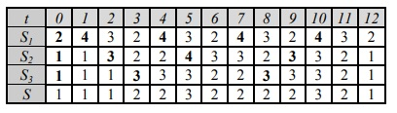
Using Counters
Notes:
Jose Manuel Urriza
- When a lower priority task is executed, higher priority counters are decremented in an amount equal to the time executed.
- When a non-critical task is executed or if there some idle time unused, all the counters would be decremented in an amount of time that is the same to the time used.
- When a task finishes is done, the Fast Slack method is then calculated to initialize the counter.
When a task finishes before its Worst Possible Case Execution Time, all lower priority counters are incremented in a time equal to the Worst Case Execution Time minus the time that the original task used to complete.
Algo needs to be calculated frequently, more hw

Slide 10
The End

Slide 11
Used Material
https://media.geeksforgeeks.org/wp-content/uploads/20200624095114/feedback.png
https://www.slideshare.net/AnilPokhrel5/slack-stealing-in-rts-ppt
https://www.researchgate.net/figure/Periodic-sporadic-and-aperiodic-task-arrival_fig2_336367207
https://www.researchgate.net/figure/Scheduling-plot-Three-periodic-tasks-are-running-on-the-same-CPU-tasks-1-and-3-having_fig1_228610754

